Slide 1
Case Study: Pacifica Coastal Issues
Sue Beckmeyer, Pacifica City Councilmember Vice Chair, CalCities Coastal Cities Group
May 18, 2023

Slide 2
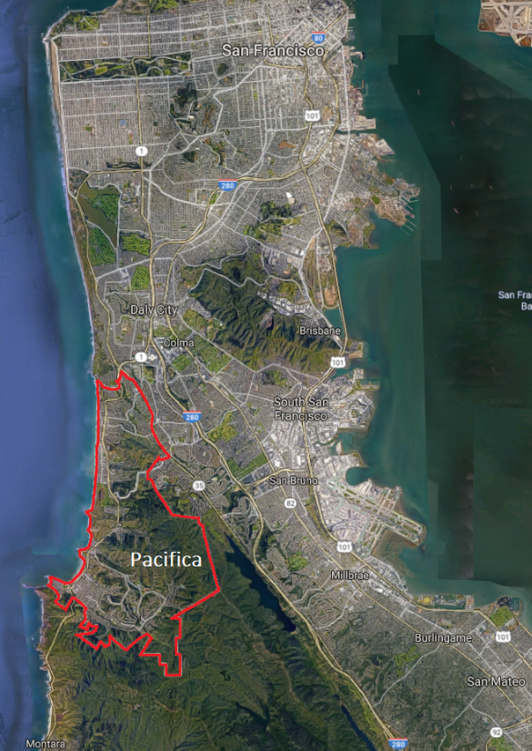
About Pacifica
6 miles of coastline
Approx. 38,000 residents
4 Business Zones in Coastal Zone
6 out of 7 hotels in Coastal Zone
Surfing destination
Regional no-cost fishing pier
Historic golf course
Public infrastructure

Slide 3
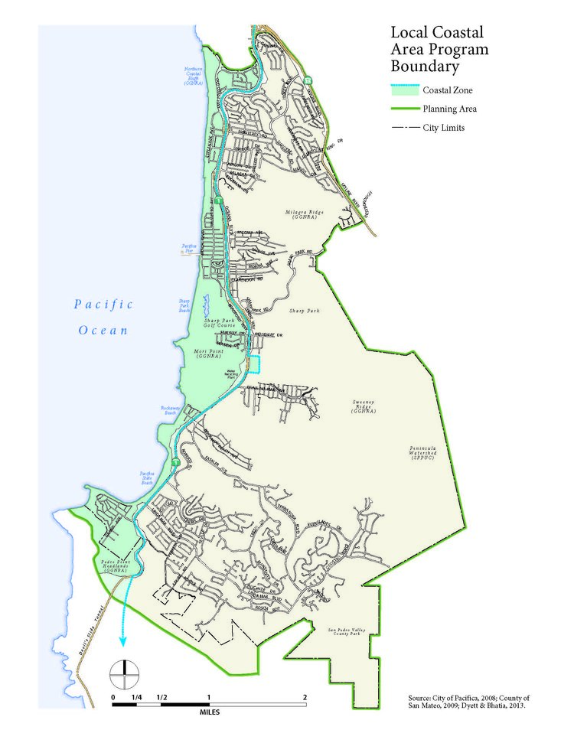
Local Coastal Land Use Plan
1980 LCLUP
2017-18 SLR Vulnerability Assessment & Adaptation Plan
2019-20 LCLUP Adoption by City Council
June 2020-Feb 2023 CCC staff review of LCLUP
On CCC Agenda March 2023
Item post postponed at City’s request
City and Coastal staff working on revisions

Slide 4
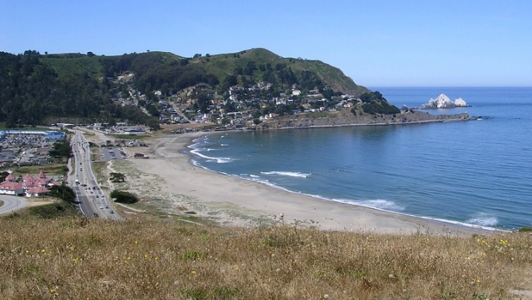
Varied Coastal Issues Require Varied Strategies Nature base Adaptation

Slide 5
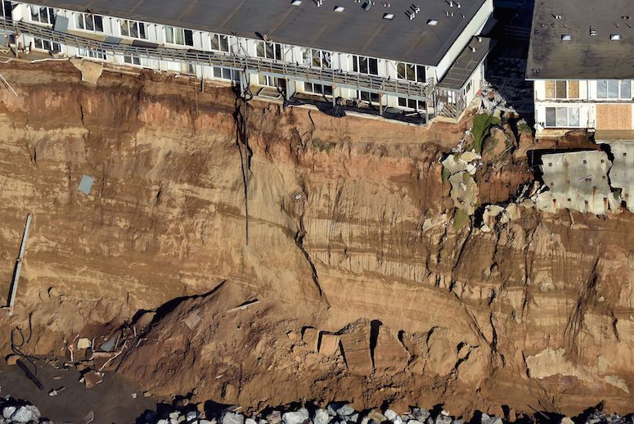
Varied Coastal Issues Require Varied Strategies
Eminent Domain

Slide 6
Varied Coastal Issues Require Varied Strategies
Short term:
Emergency Repairs

Slide 7
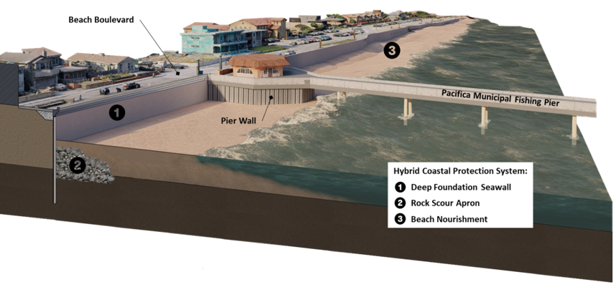
Varied Coastal Issues Require Varied Strategies
Long Term – Seawall & Beach Nourishment

Slide 8
Questions?
Sue Beckmeyer
sbeckmeyer@pacifica.gov

